Slide 1

Python

Slide 2

Building Blocks: Variables & Data Types
At the heart of any program is data. Variables are named storage locations that hold different types of data, acting as containers for information your program uses. Understanding data types helps you manipulate information effectively.
Python automatically infers the data type based on the value assigned, making it incredibly flexible.
# Integerage = 30 # Floatpi = 3.14159# Stringname = "Alice"# Booleanis_student = True# Listcolors = ["red", "green", "blue"]
From simple numbers to complex structures, Python offers a rich set of built-in types to handle your data needs.

Slide 3



Making Decisions: Conditional Statements
Programs often need to make decisions based on certain conditions. Python's conditional statements (`if`, `elif`, `else`) allow your code to execute different blocks of logic depending on whether specified conditions are true or false.
Check Condition
Optional Alternative
Default Action
Start with an if statement.
Add elif for more conditions.
Use else for everything else.
temperature = 25if temperature > 30: print("It's a hot day!")elif temperature > 20: print("It's a pleasant day.")else: print("It's a bit chilly.")
This fundamental control flow mechanism is crucial for creating dynamic and responsive applications.

Slide 4


Repetitive Tasks: Loops
When you need to perform an action multiple times, loops are your best friends. Python provides for loops for iterating over sequences and while loops for repeating actions until a condition is met.
For Loops
While Loops
Ideal for iterating over sequences (lists, tuples, strings, ranges) where the number of iterations is often known in advance.
Executes a block of code repeatedly as long as a specified condition is true. Be careful of infinite loops!
count = 0while count < 3: print(f"Count: {count}") count += 1
fruits = ["apple", "banana"]for fruit in fruits: print(fruit)
Mastering loops allows you to automate tasks and process large datasets efficiently.

Slide 5




Organizing Data: Python Collections
Beyond single values, Python offers powerful collection types to store and manage groups of data. Each type serves a distinct purpose, providing flexibility for various programming scenarios.
Lists
Tuples
Ordered, changeable, allows duplicate members. Defined by square brackets.
Ordered, unchangeable (immutable), allows duplicate members. Defined by parentheses.
Sets
Dictionaries
Unordered, unindexed, no duplicate members. Defined by curly braces.
Unordered, changeable, indexed (key-value pairs), no duplicate keys. Defined by curly braces.
Choosing the right collection type can significantly impact your code's performance and readability.

Slide 6
Collections in Action
Let's see how these fundamental collection types are used with practical examples. Notice their distinct behaviors for different data management needs.
Lists: Dynamic Sequences
Tuples: Immutable Data
Sets: Unique Elements
Dictionaries: Key-Value Mapping
Lists are mutable, making them perfect for collections that frequently change.
Tuples provide data integrity as their elements cannot be changed after creation.
Sets are excellent for membership testing and removing duplicate entries.
Dictionaries store data in key-value pairs, allowing for efficient data retrieval.
my_list = [1, 2, "three"]my_list.append(4)print(my_list[0]) # Output: 1
my_tuple = (10, 20, "thirty")print(my_tuple[1]) # Output: 20# my_tuple.append(40) would error
my_set = {1, 2, 2, 3}my_set.add(4)print(my_set) # Output: {1, 2, 3, 4}
my_dict = {"name": "Bob", "age": 25}print(my_dict["name"]) # Output: Bobmy_dict["age"] = 26
These examples illustrate the versatility of Python's built-in data structures.

Slide 7
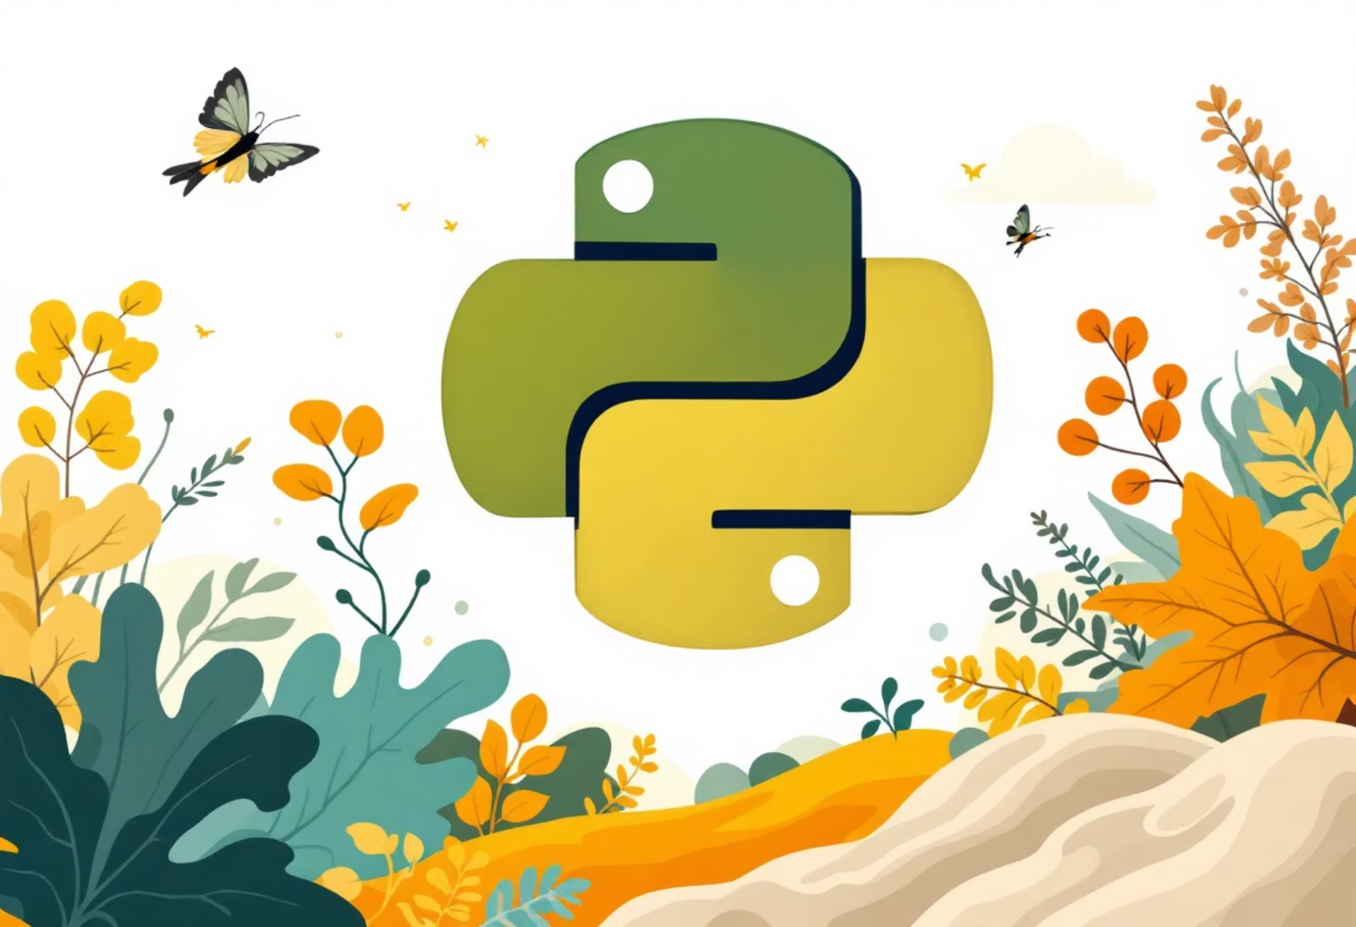
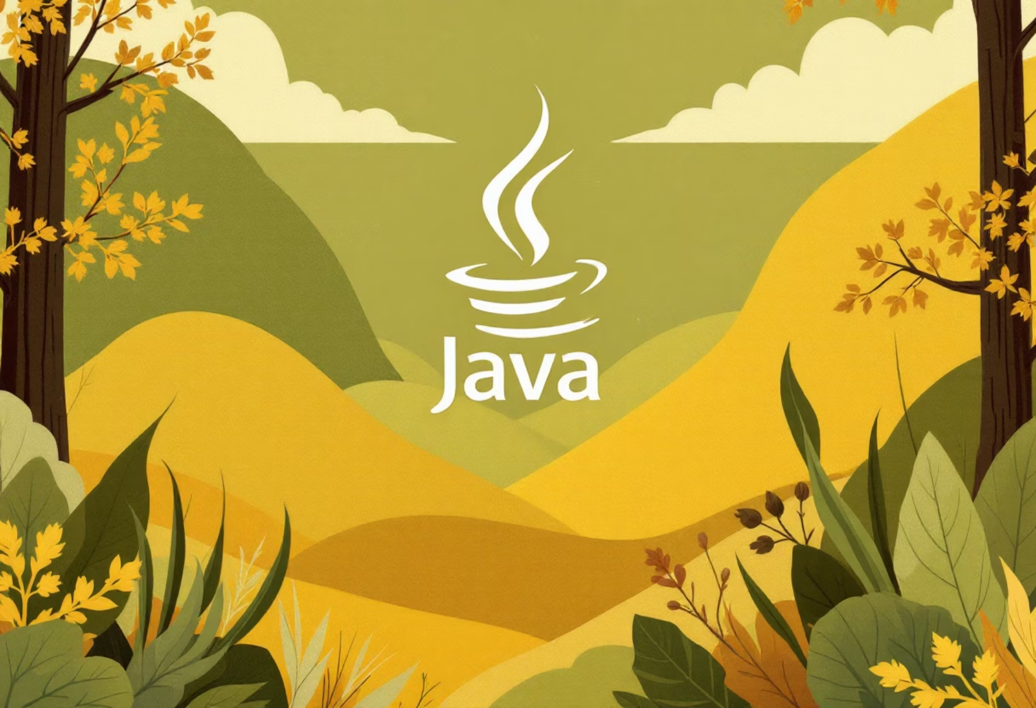
Reusable Code: Functions
Functions are blocks of organized, reusable code that perform a single, related action. They promote modularity and code reuse, making your programs easier to manage, debug, and extend.
Python Function
Java Equivalent
def greet(name): """ This function greets the person passed in as a parameter. """ return f"Hello, {name}!"message = greet("Graduates")print(message) # Output: Hello, Graduates!
public class Greeter { public static String greet(String name) { return "Hello, " + name + "!"; } public static void main(String[] args) { String message = greet("Graduates"); System.out.println(message); }}
Python functions are concise and use indentation to define scope. They can accept arguments and return values.
Compared to Java, Python's syntax for defining functions is significantly less verbose, emphasizing readability.
Embracing functions is key to writing clean and maintainable code in any language.

Slide 8
Advanced Python: Concise & Functional
Python offers elegant features for writing more compact and expressive code. List comprehensions and lambda functions are powerful tools for functional programming paradigms.
List Comprehension
Lambda Functions
A concise way to create lists. It reads almost like natural language, making code more readable than traditional loops.
Small, anonymous functions defined with the lambda keyword. Often used for short-term operations, especially with map() and filter().
# Squares of numbers from 0 to 4squares = [x**2 for x in range(5)]print(squares) # Output: [0, 1, 4, 9, 16]
# Doubling numbers using lambda and mapnumbers = [1, 2, 3]doubled = list(map(lambda x: x * 2, numbers))print(doubled) # Output: [2, 4, 6]
These features allow for powerful data transformations in fewer lines of code.

Slide 9
Advanced Python: Structure & Reusability
As your projects grow, structuring your code becomes crucial. Object-Oriented Programming (OOP) and Modules provide mechanisms for creating organized, scalable, and reusable applications.
Object-Oriented Programming (OOP)
Modules
Python supports OOP principles like classes and objects, enabling you to model real-world entities and their interactions.
Python modules are files containing Python definitions and statements. They allow you to logically organize your Python code, making it easier to manage and reuse.
class Dog: def __init__(self, name): self.name = name def bark(self): return f"{self.name} says Woof!"my_dog = Dog("Buddy")print(my_dog.bark())
# my_module.py:# def add(a, b): return a + b# main.py:import my_moduleresult = my_module.add(5, 3)print(result) # Output: 8
OOP and modules are essential for building complex, maintainable applications.

Slide 10
Graceful Exits: Error Handling & Next Steps
Even the best code can encounter unexpected issues. Python's error handling with try, except, and finally blocks allows your program to gracefully manage errors, preventing crashes.
01
02
03
Try Block
Except Block
Finally Block
Code that might raise an exception goes here.
Handles specific exceptions if they occur in the try block.
Executes cleanup code, regardless of whether an exception occurred or not.
try: result = 10 / 0except ZeroDivisionError: print("Cannot divide by zero!")finally: print("Execution complete.")
Your Python Journey Continues!
Python's intuitive syntax, vast ecosystem of libraries, and strong community support make it an ideal language for new graduates. Unlike more verbose languages, Python allows for rapid development and focuses on readability.
Mini-Project Challenge
Your task: Write a Python script that takes a user's name and age, then calculates their birth year and prints a personalized message. Implement error handling for invalid age input.
Keep coding, keep exploring, and welcome to the world of Python!

